Slide 1


Digital Doctor for Pneumonia
Your health assistant
The problem: In rural areas people face difficulties or have no access to health facilties. Pneumonia is a common disease in these areas.
Our solution: We provide an application through which they can not only detect pneumonia, but also can get doctor’s advice and home remedies.

Slide 2




Team
Aaira Suhail Sheryar Zahid Iqra Shahzad Syed M. Hassan

Slide 3

Simple Task
To check for home remedies
Moderate Task
Input values from blood report
Complex Task
To check for respiration using digital stethoscope
Situation: the user know that he/she is suffering from a disease and wants to know want remedies he/she can do to cure it.
Situation: the user is literate enough and he/she knows how to read the blood report. He can enter in CBC and other values to get more accurate results.
Situation: the user is aware about the usage of stethoscope and auscultation points. He can place the stethoscope over his/her chest to get the readings for respiration.

Slide 4
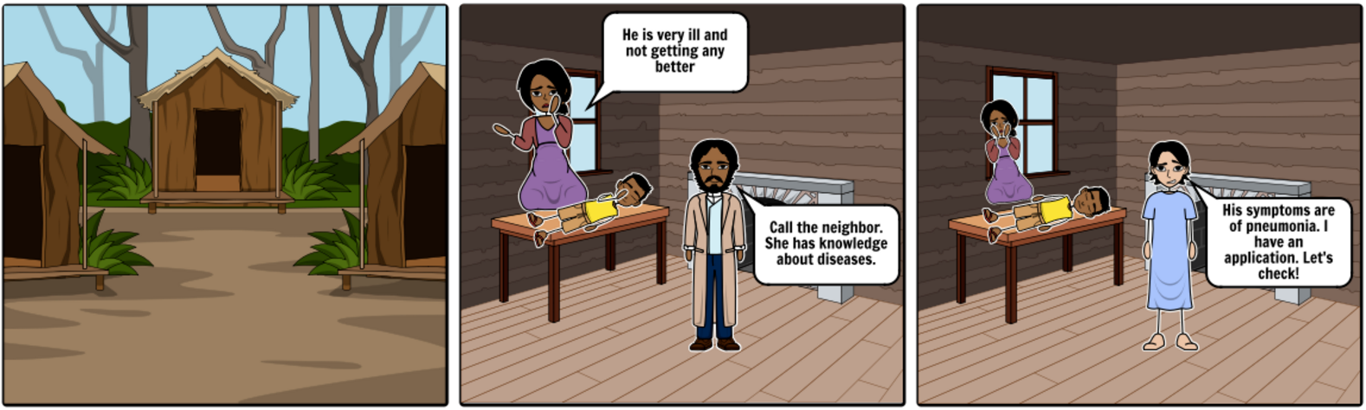
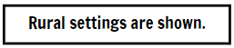
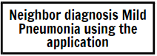
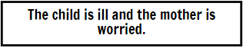
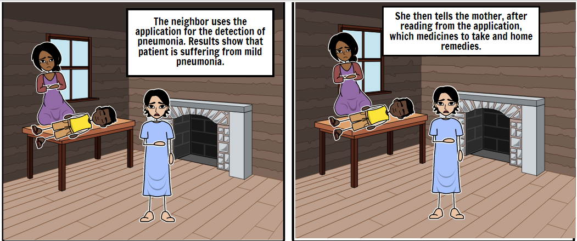
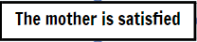
Storyboard
The video:https://www.youtube.com/watch?v=gngbrNnmW1Y

Slide 5
Thanks! :)

